Slide 1
Pet Best LLC
IT Solution

Slide 2








Meet the Team – Front End
Ahmad
Mohammed
Melody
Brandon
Sameha
Our mission is to help the customer bring in more business with a professional and responsive website.

Slide 3
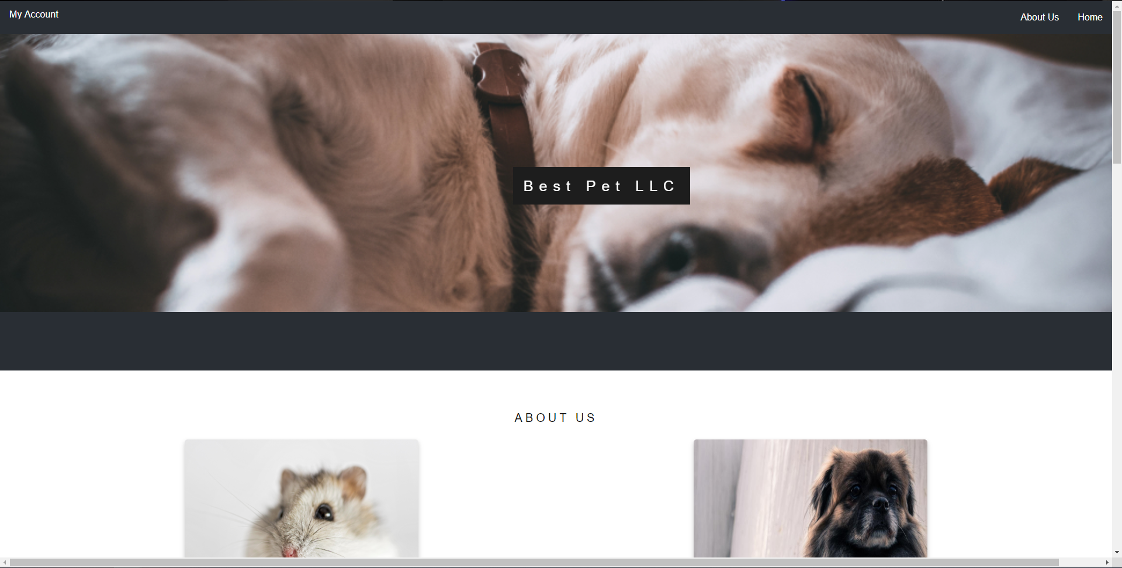
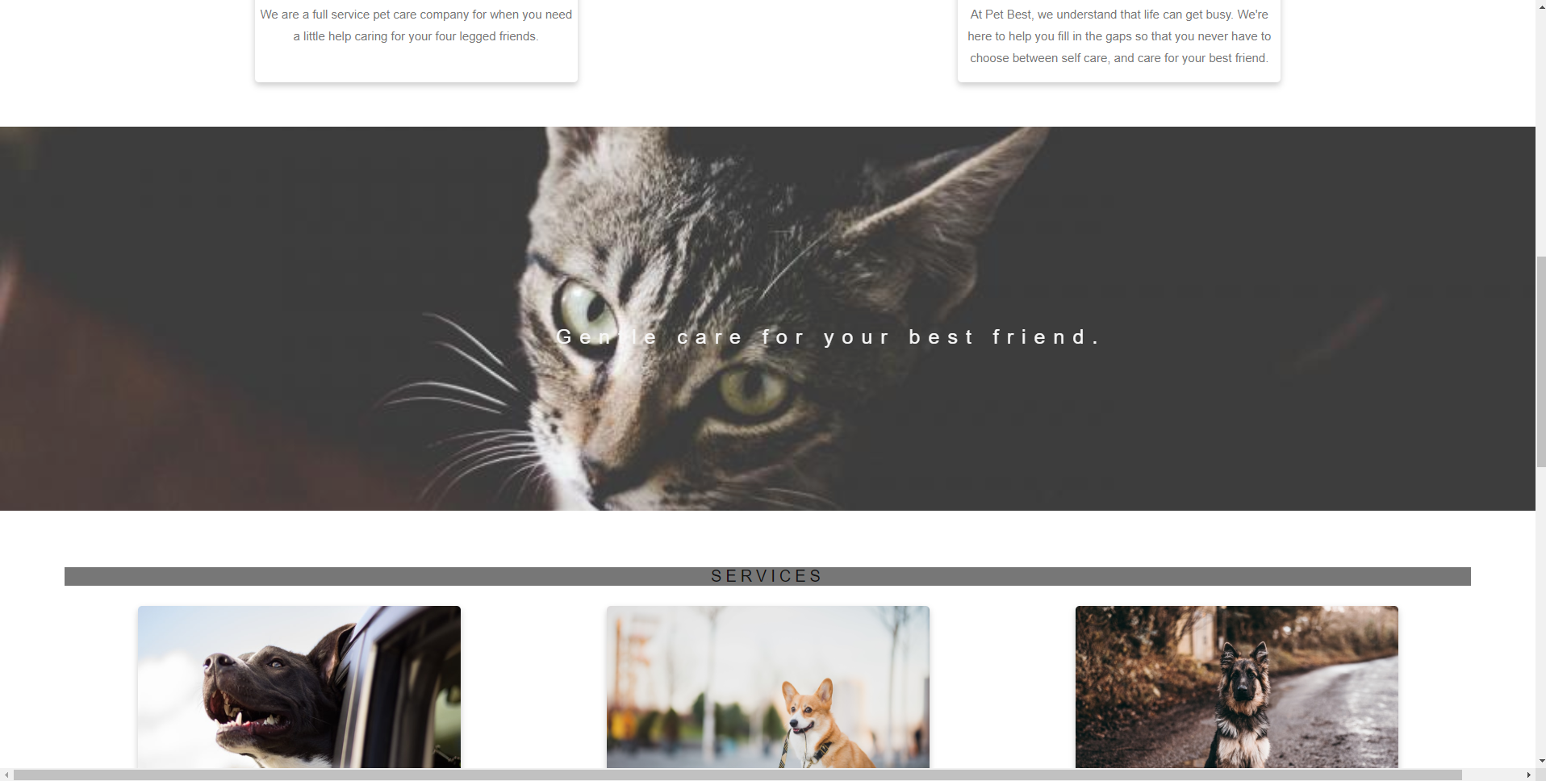
What We've Done for Pet Best
Create web pages that has a unique design for Pet Best
Make sure overall appearance is well assessed and visually appealing
Show case all information regarding Pet Best and their content

Slide 4
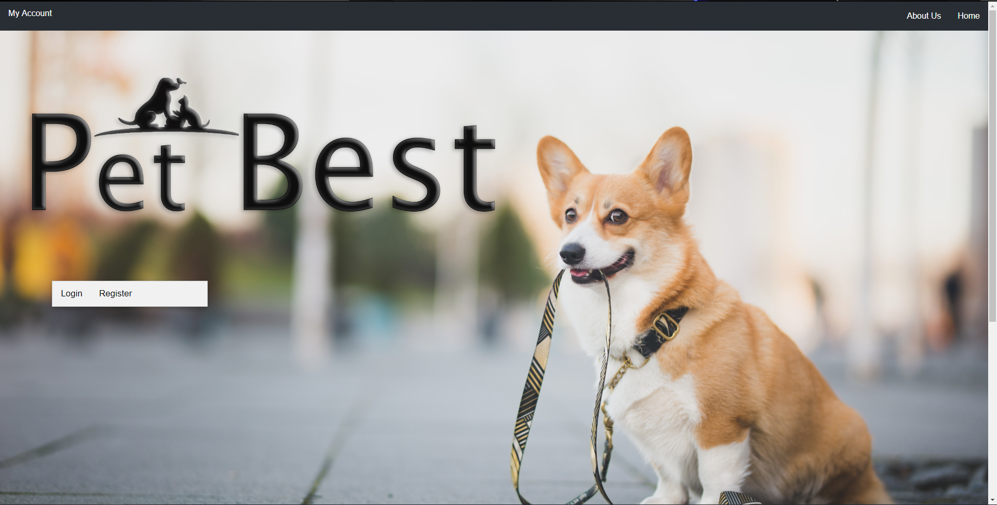
Home Screen
Nice simple design, with a parallax effect
Allows access to features like viewing the About Us page, creating an account, and logging into an account using either the My Account tab or Login link

Slide 5
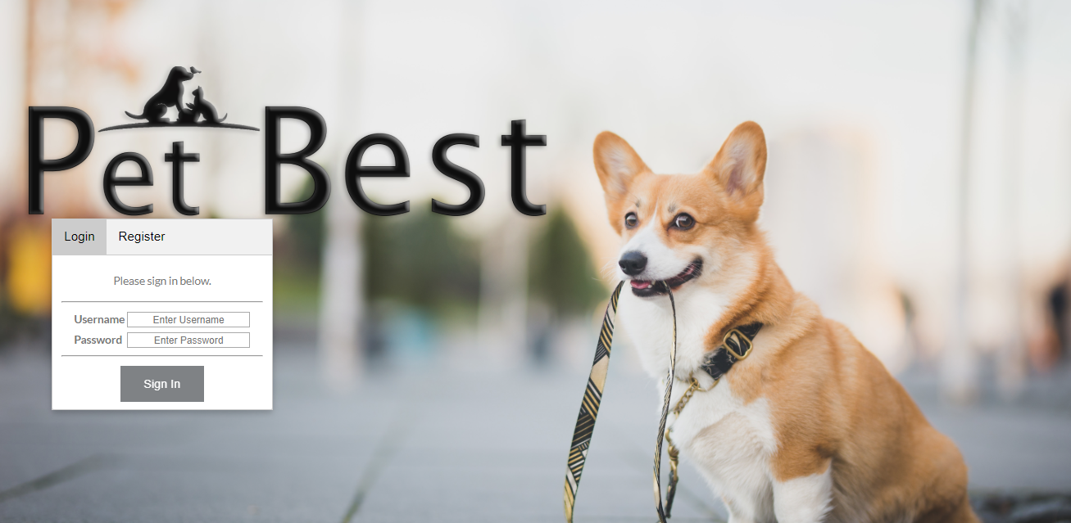
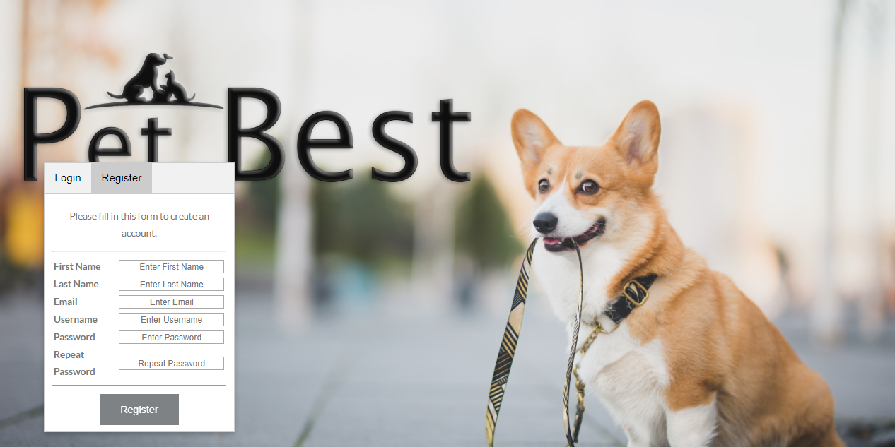
Sign In and Register Page
Here the customer will be asked to sign in.
Don't have an account? Register!

Slide 6
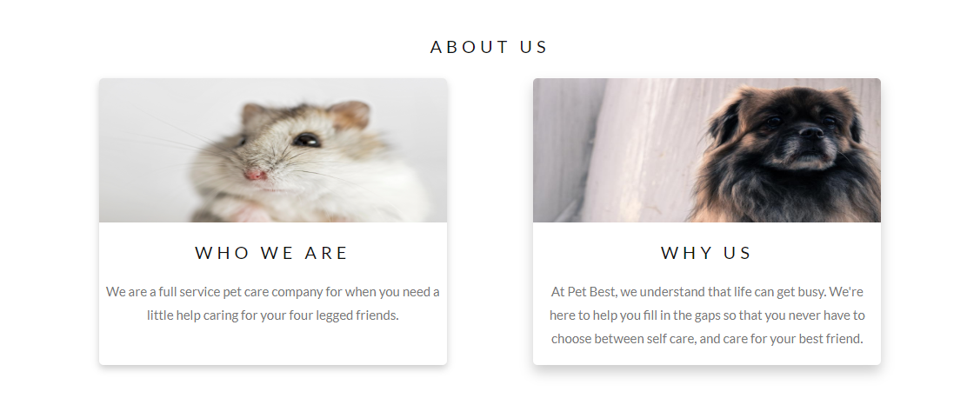
About Us Page

Slide 7
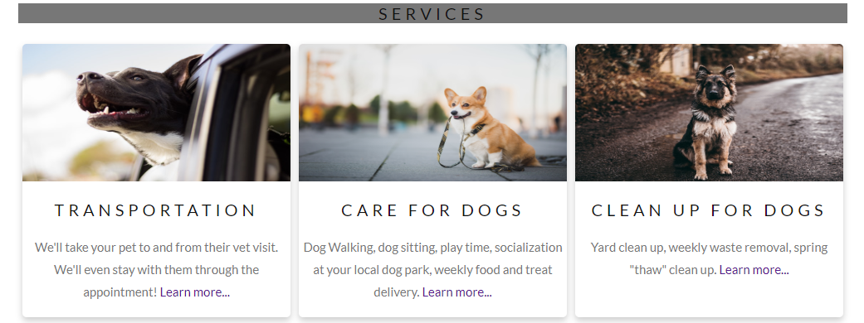
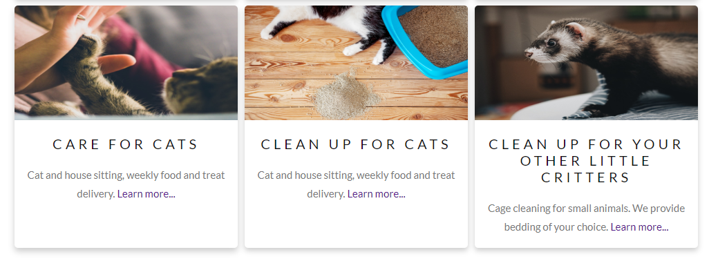
About Us Continued...

Slide 8
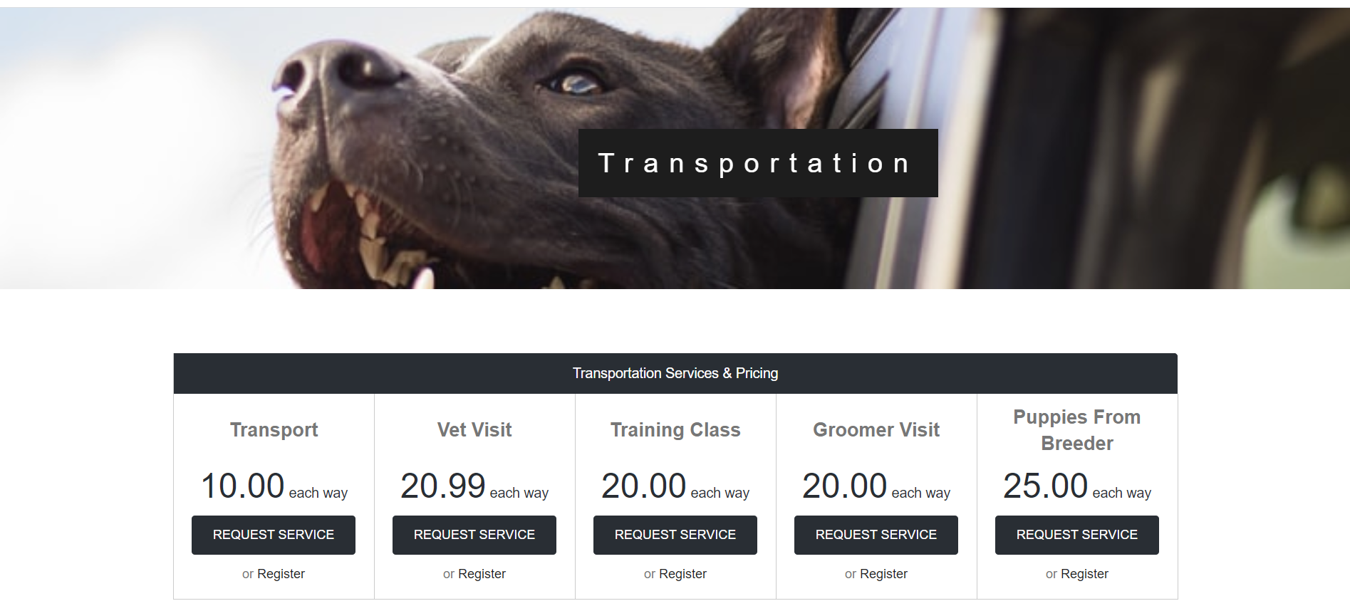

Slide 9
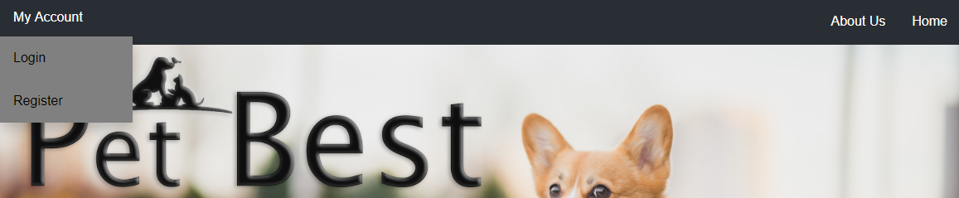
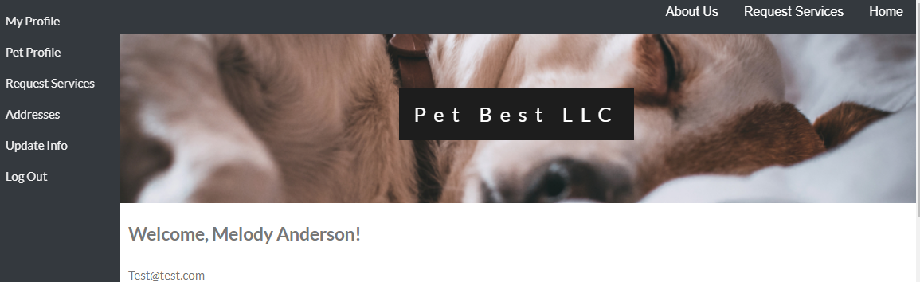
Menu Features

Slide 10

Site Tour

Slide 11
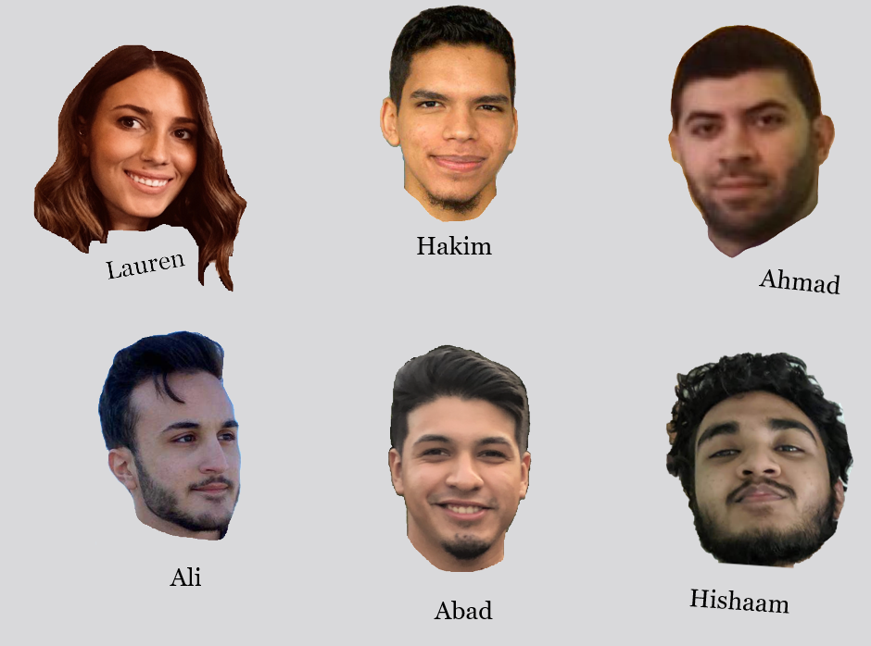
App-Dev
The App-Dev team mission is to give admins a clean and simple interface for viewing and manipulating user data

Slide 12
Application Features
Creating user and pet accounts
Creating and assigning orders
Viewing employee schedules
Viewing invoices
Creating customized reports
Administrative
Based

Slide 13
API Communication
API (Application Programming Interface)
REST API
Database
REST API
App / Website
Data
Data
Request
Request

Slide 14
Benefits of API Communication
Data consistency between app and website
Saves development time for multiple teams
Flexibility between platforms

Slide 15






Back-End
Team Lead
#4
Brian
Murad
Aldura
Wedad
#6
Fouad
Alex
The Back-End team mission is to give each team a way to access the database and perform key tasks essential to Pet Best IT Solution.

Slide 16
Services
Admin
Services
Employee
Services
Customer
Services
Some services are used by all three parties.

Slide 17
Admin Services
Customers View
Customers Pets
Current Orders
Invoices
Employee List
Services Update
Add Employee
The administrator is the one who will run, monitor, and reconfigure the site when necessary using these available services.

Slide 18
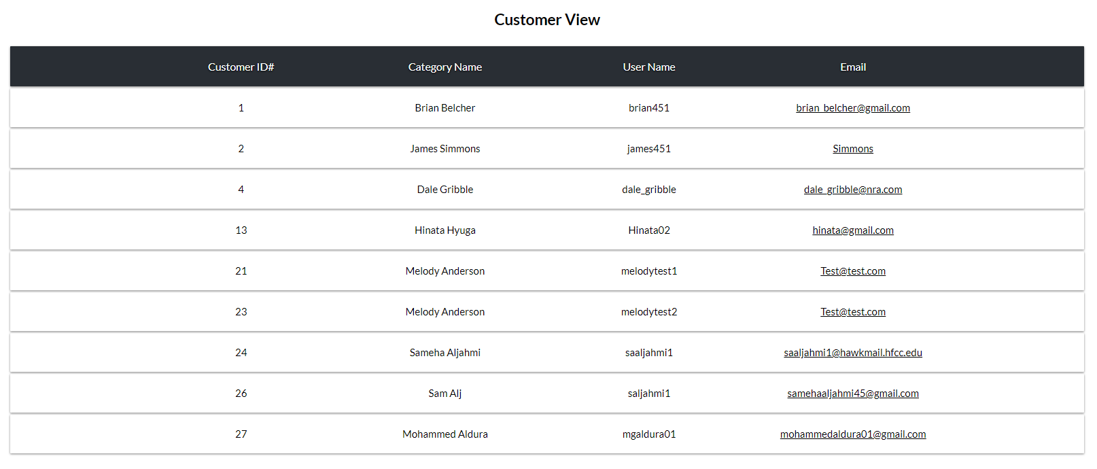
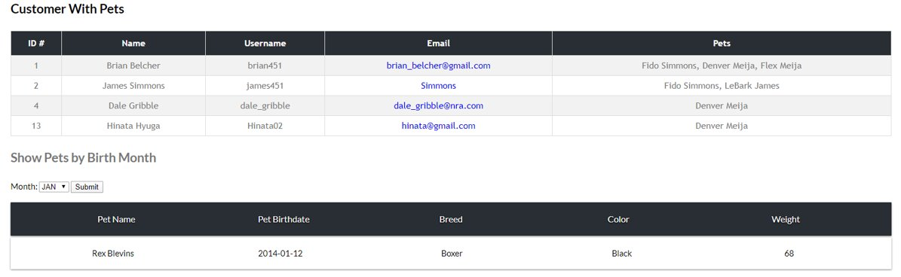

Slide 19
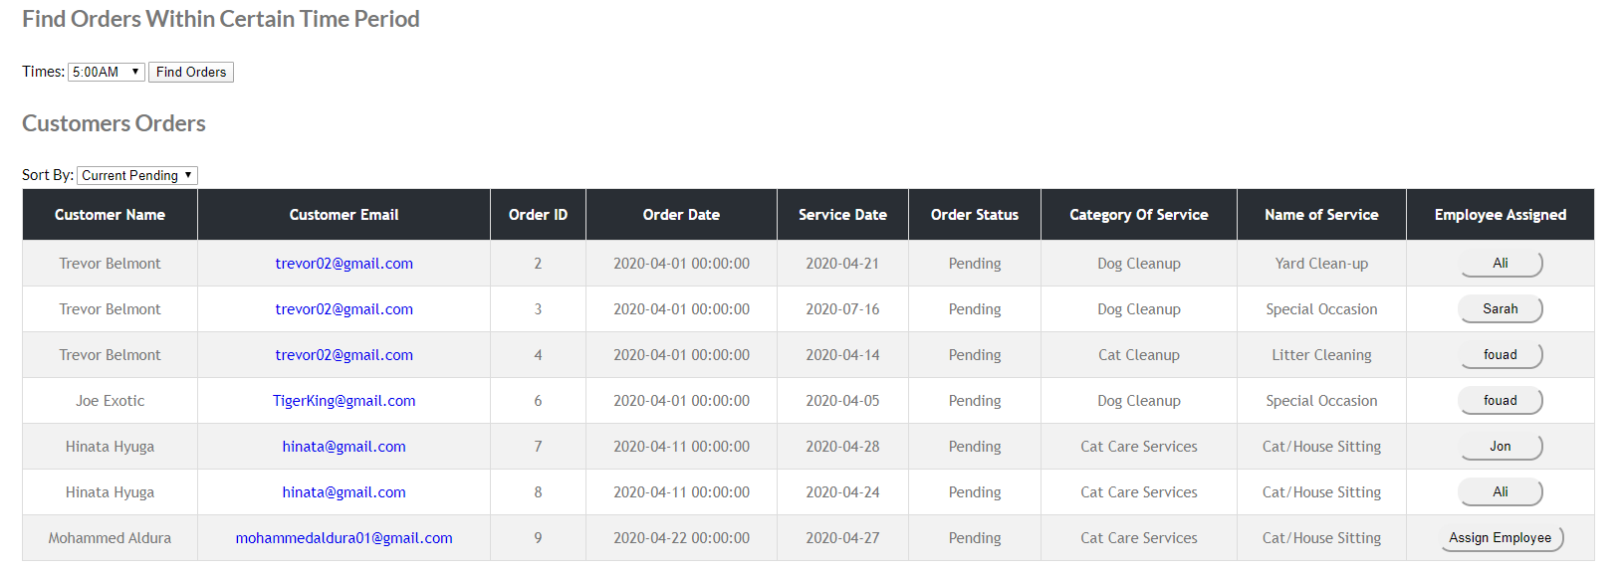
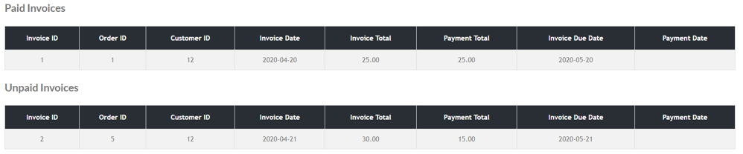
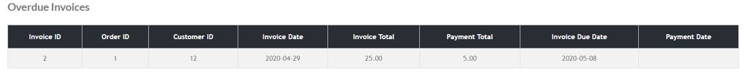

Slide 20
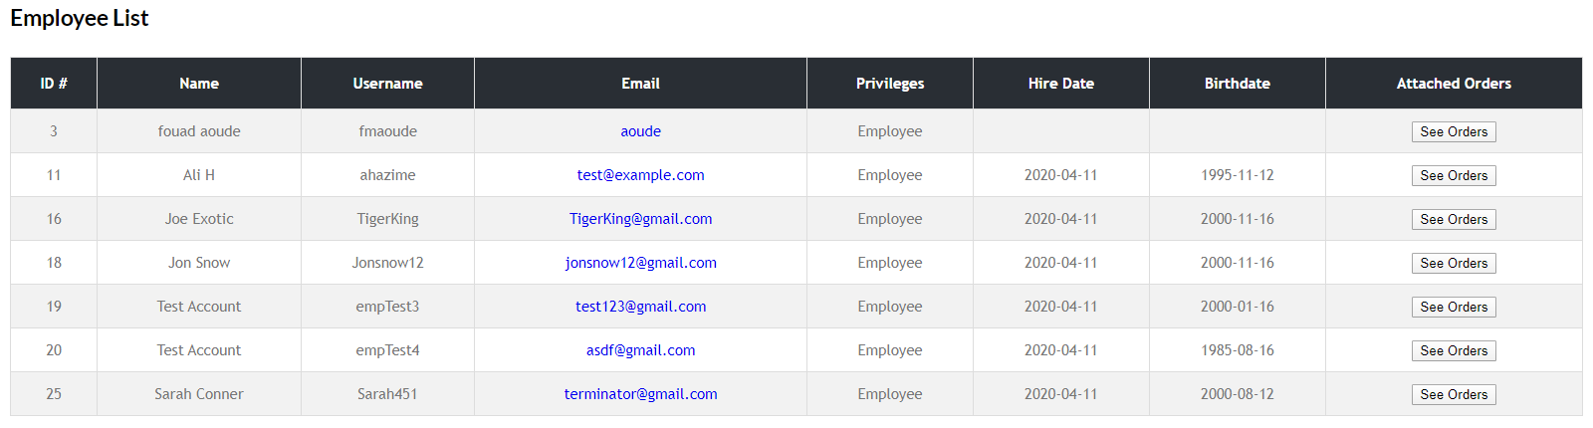
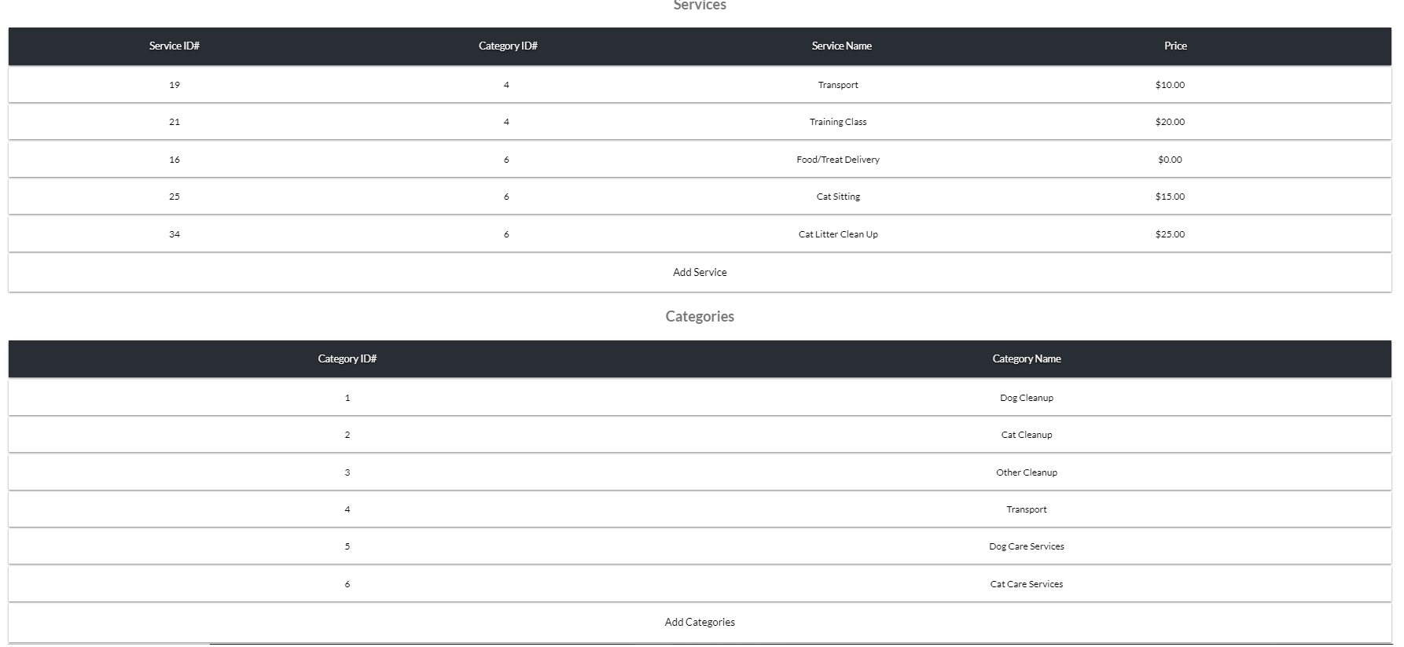
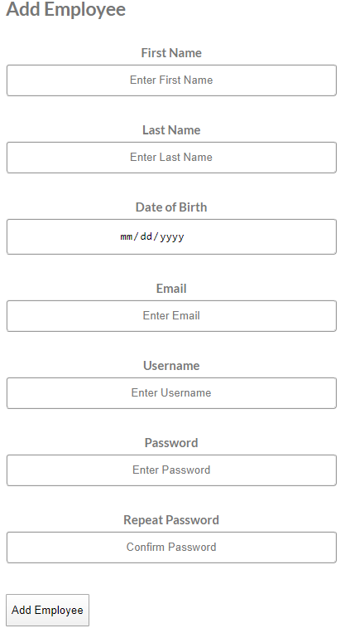

Slide 21
Employee Services
The employees will have access to services that will allow them to efficiently process and complete requests through the website.
My Profile
Active Jobs

Slide 22
Employee Services Continued
My Profile
Displays employee's name and email
Active Jobs
Shows a list of jobs that the employee can display via a filter of Active jobs, Completed jobs, and Cancelled jobs
They can also modify order status or submit an order for completion and send the customer a receipt/invoice

Slide 23
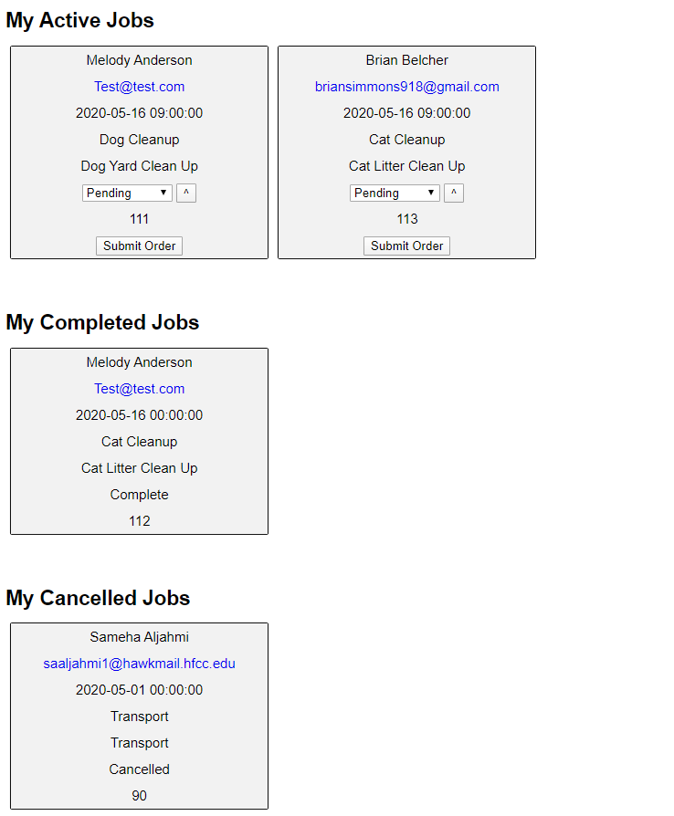
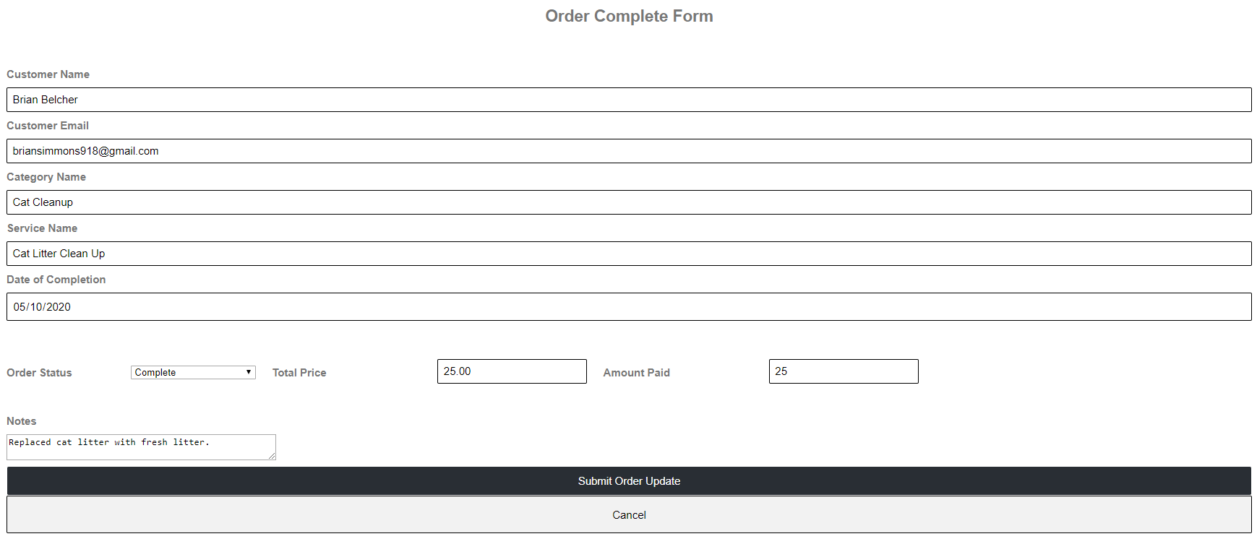
Examples of activeJobs (pictured left) and employeeUpdate webpages (pictured below)

Slide 24
Customer Services
My Profile
Pet Profile
Addresses
Request Services
Update Info
The customers will have access to tools and services that allow them to choose what is best suited for their needs.

Slide 25
Customer Services
Shows active orders, list of pets, and past customer orders
Allows customer to select a service from the drop down menu
My Profile
Pet Profile
Request Services
The Pet Profile Form allows customers to add a pet and then it sends them to their profile page
Addresses
Update Info
Allows customer to add their address and phone number for contact information
Allows user to update personal information and change password.

Slide 26
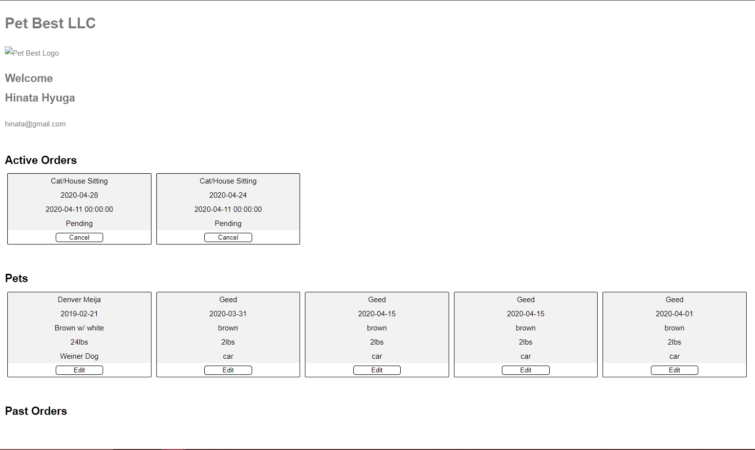
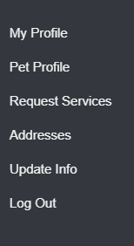
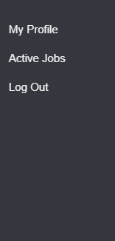
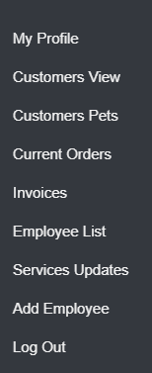
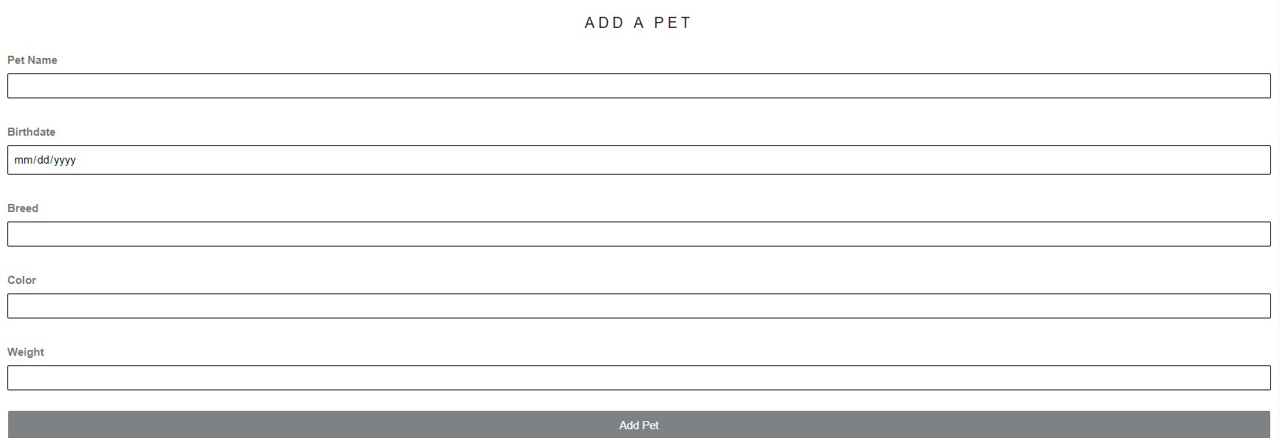
Example of the profile page with Active Orders, Pets, and Past Orders tabs
Customer
Employee
Admin
Shown is the Pet Profile page to add a pet to the user's profile page

Slide 27
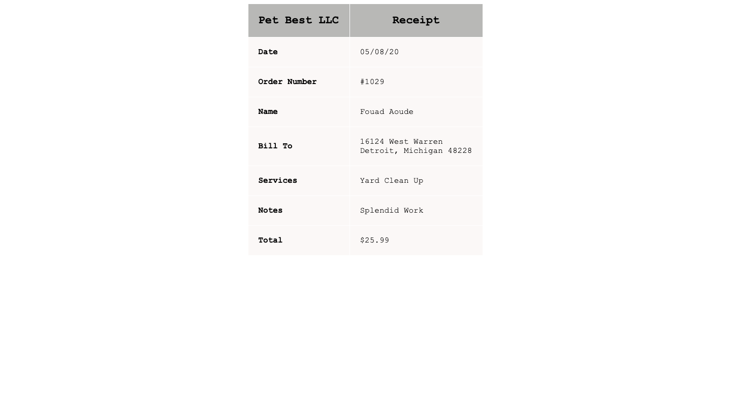
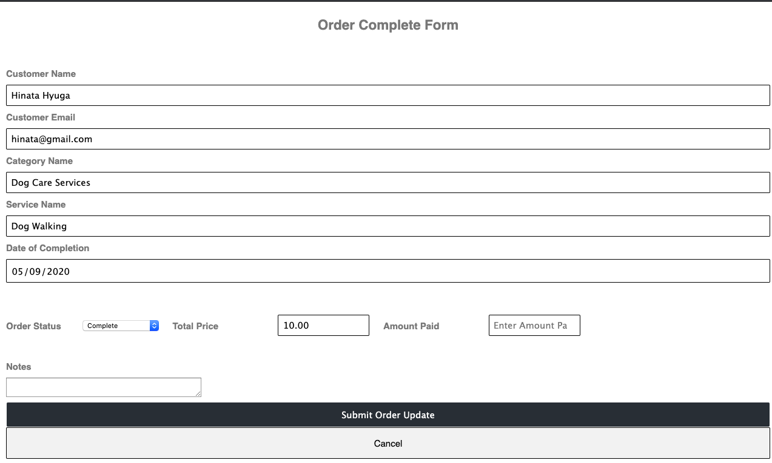
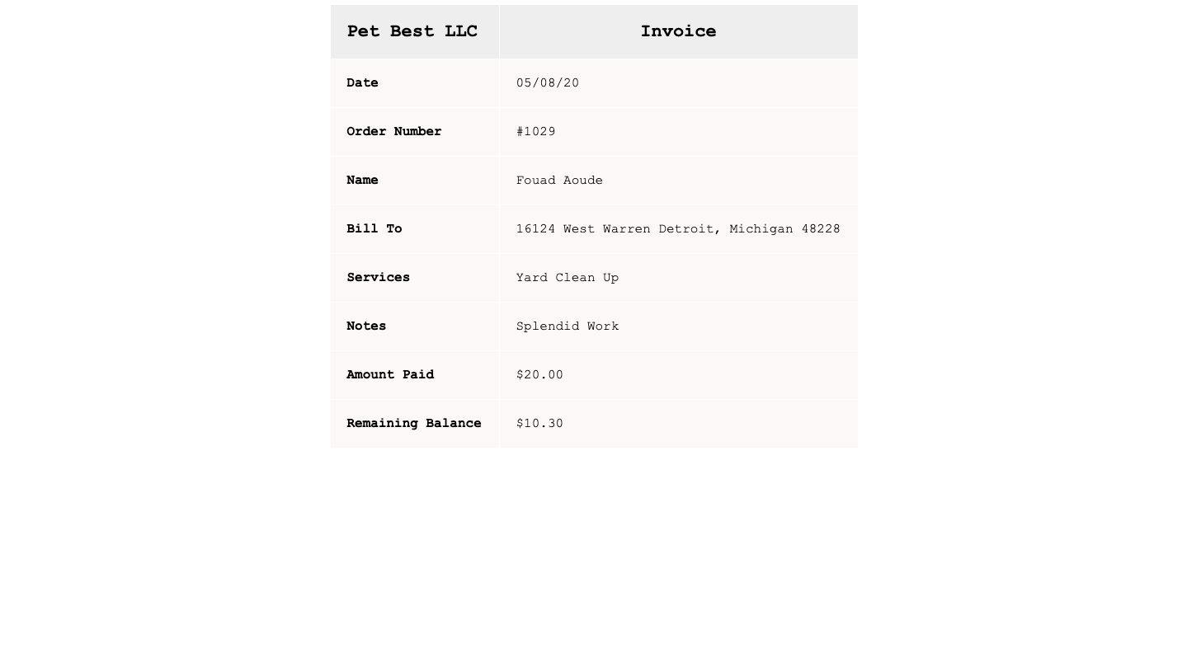
Email Functionality

Slide 28
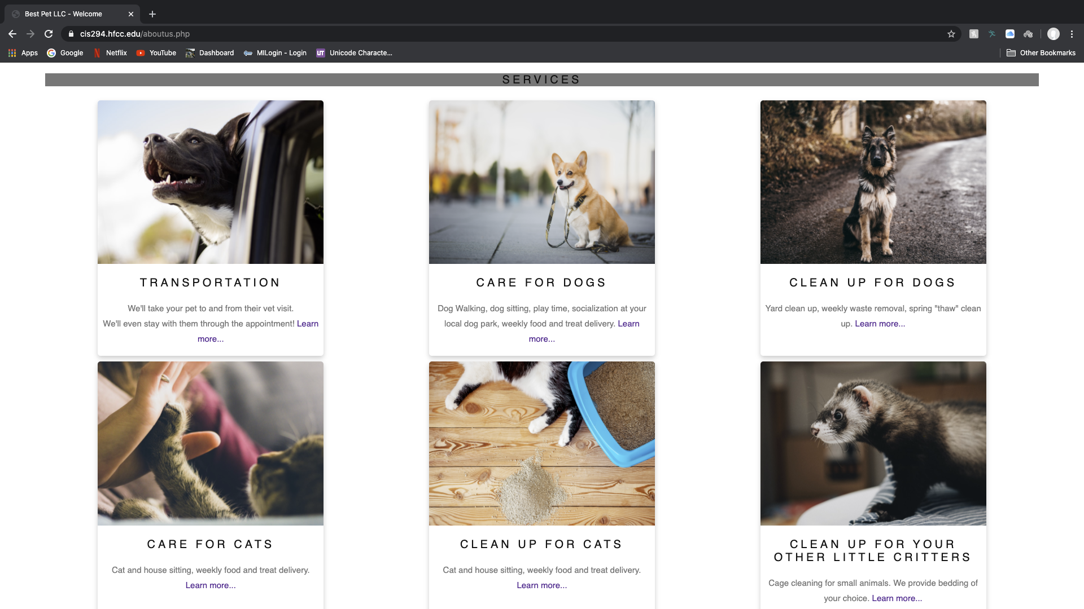
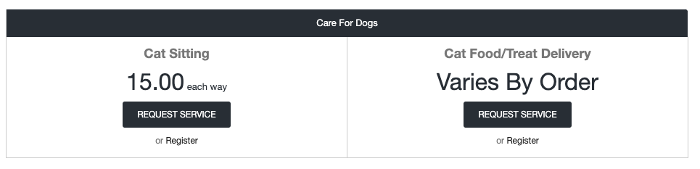
Guest Services

Slide 29


Server
Emad
Ali El-Ali
The Server team mission is to enable all teams to develop and collaborate on each component of the Pet Best IT solution.

Slide 30
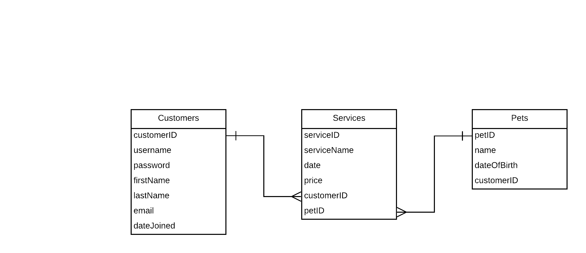
Server Set-Up
Server Hardware
CentOS 8
Apache
MariaDB
RDBMS
PHP Support

Slide 31
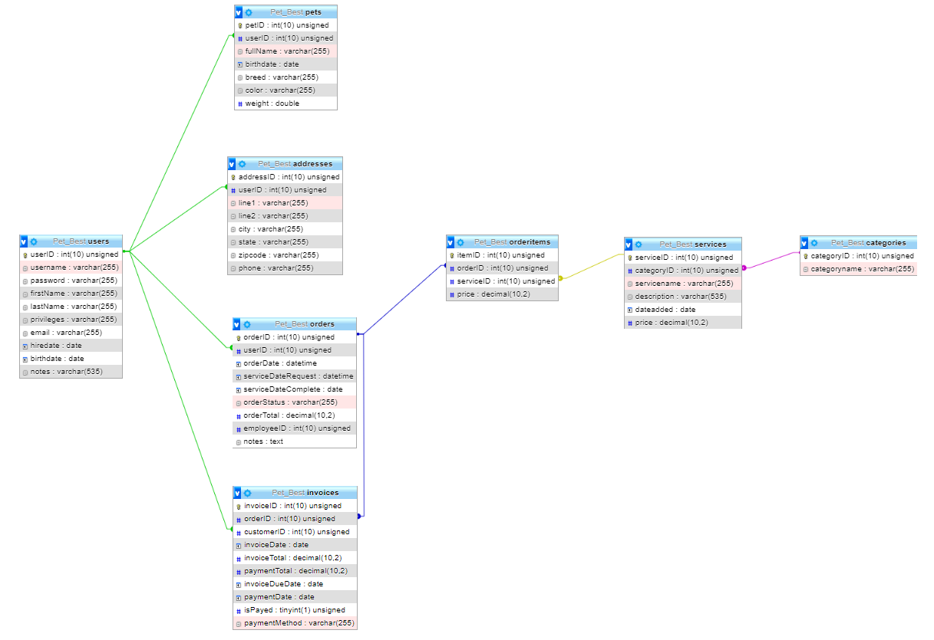
Database Relationship Diagram

Slide 32
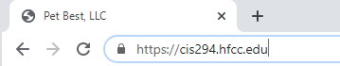
Website
HTTP
HTTPS
Automatic Website Updates
phpMyAdmin

Slide 33

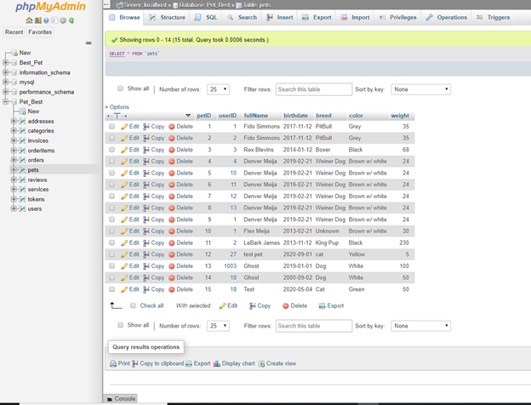
Pet Best Database
Pets Table
All Tables

Slide 34

ROOT
WEBTEAM
Created for website files and deployment.
MAILTO
Scripts that manage the website's code should not run as root.
Webhook only works on GITLAB server, will create a temp file.
Created after adding cron entry to run script once per minute. Also, set to deliver mails from the repository to a log file.
Webhook_cron.php will allow to process webhook.
Virtual Host
Virtual Host configurations to redirect traffic to https.
Configured to specify Server Name: cis294.hfcc.edu
BackEnd
FrontEnd
Apache Server
AppDev

Slide 35
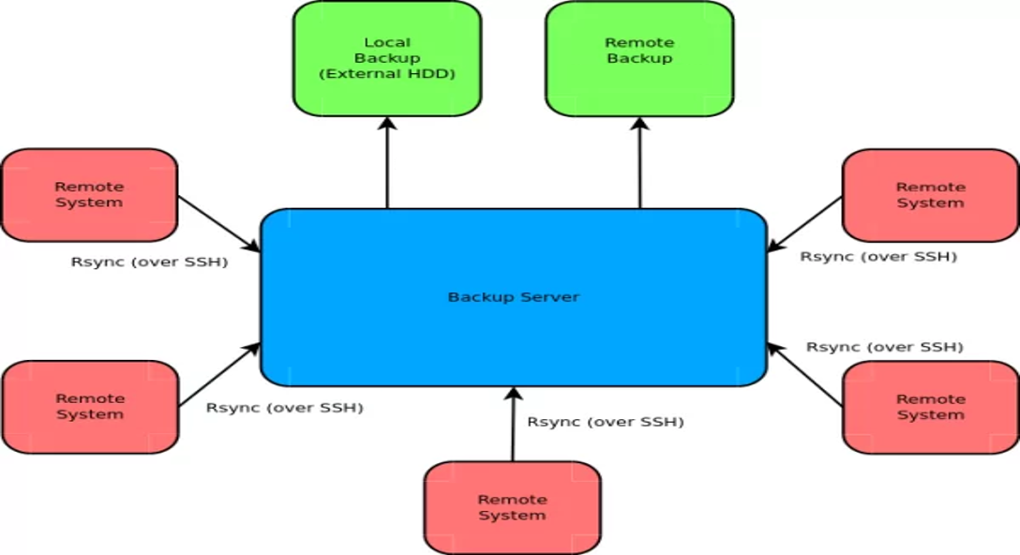
Backup Server
Rsync (Remote Sync) is a command that's used commonly for copying and synchronizing files and directories remotely as well as locally in Linux/Unix systems.

